Slide 1
Cascade Correlation
Architecture and Learning Algorithm for Neural Networks

Slide 2
Outline
What is Cascade Correlation ?
NN Terminology
CC Architecture and learning Algorithm
Advantages of CC
References

Slide 3
What is Cascade Correlation ?
Cascade-correlation (CC) is an architecture and generative, feed-forward, supervised learning algorithm for artificial neural networks.
Cascade-Correlation begins with a minimal network, then automatically trains and adds new hidden units one by one creating a multi-layer structure.

Slide 4
NN Terminology
An artificial neural network (ANN) is composed of units and connections between the units. Units in ANNs can be seen as analogous to neurons or perhaps groups of neurons.
Connection weights determine an organizational topology for a network and allow units to send activation to each other.
Input units code the problem being presented to the network.
Output units code the network’s response to the input problem.

Slide 5
NN Terminology
Hidden units perform essential intermediate computations.
Input function is a linear component which computes the weighted sum of the units input values.
Activation function is a non-linear component which transforms the weighted sum in to final output value
In cascade-correlation, there are cross-connections that bypass hidden units.

Slide 6
CC Architecture and learning Algorithm
Cascade-Correlation (CC) combines two ideas:
The first is the cascade architecture, in which hidden units are added only one at a time and do not change after they have been added.
The second is the learning algorithm, which creates and installs the new hidden units. For each new hidden unit, the algorithm tries to maximize the magnitude of the correlation between the new unit's output and the residual error signal of the network.

Slide 7
The Algorithm
CC starts with a minimal network consisting only of an input and an output layer. Both layers are fully connected.
Train all the connections ending at an output unit with a usual learning algorithm until the error of the net no longer decreases.
Generate the so-called candidate units. Every candidate unit is connected with all input units and with all existing hidden units. Between the pool of candidate units and the output units there are no weights.

Slide 8
The Algorithm
4. Try to maximize the correlation between the activation of the candidate units and the residual error of the net by training all the links leading to a candidate unit. Learning takes place with an ordinary learning algorithm. The training is stopped when the correlation scores no longer improves.
5. Choose the candidate unit with the maximum correlation, freeze its incoming weights and add it to the net.

Slide 9
The Algorithm
To change the candidate unit into a hidden unit, generate links between the selected unit and all the output units. Since the weights leading to the new hidden unit are frozen, a new permanent feature detector is obtained. Loop back to step 2.
This algorithm is repeated until the overall error of the net falls below a given value

Slide 10
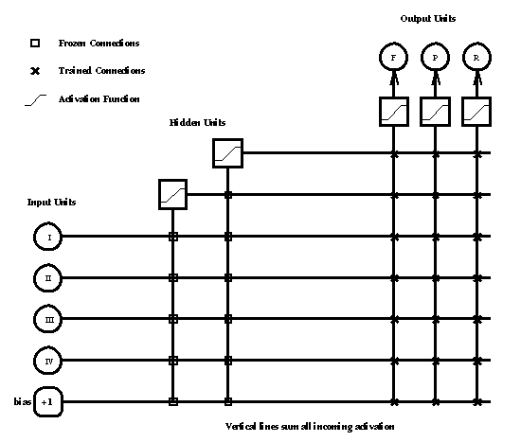
A Neural Network trained with Cascade Correlation Algorithm

Slide 11
Advantages of CC
It learns at least 10 times faster than standard Back-propagation Algorithms.
The network determines its own size and topologies.
It is useful for incremental learning in which new information is added to the already trained network.

Slide 12
References
The Cascade Correlation Learning Architecture. Scott Fahlman and Christian Lebiere.
A Tutorial on Cascade-correlation. Thomas R. Shultz

